Slide 1
Software Development with UML and Java 2

Slide 2
Agenda
Recap
Observable model
Observable properties

Slide 3
MVVM
About keeping a clean structure in your program.
You might be using it on the client side of your SEP2 project (and maybe server side)

Slide 4
Parts
View
View model
Model

Slide 5
Parts
Input validation
Presentation
Take user input
User event handling
Data
Business logic
(data manipulation)
GUI state
Data validation
Storage/
data base
Rendering
Translation
Parsing (XML, JSON)
Formatting
Networking
Here we put FXML, and View classes (called controllers in JavaFX
Mediator between the two.
Each View has a View Model
Classes about data, rules, logic
View
View model
Model

Slide 6
Parts
Networking
Input validation
Presentation
User event handling
Storage/
data base
Data validation
Take user input
Formatting
Data
Translation
Rendering
GUI state
Business logic
(data manipulation)
Parsing (XML, JSON)
View
View model
Model

Slide 7
The View knows about the View model (reference)
The View model knows about the Model (reference)
Nothing is know the opposite way: The Model doesn’t know about the View model, and the View model knows nothing about the View.
One way dependencies
Bindings
View
View model
Model
Has a reference
Has a reference
notifications
The ViewModel updates the View through property-bindings
The Model updates the ViewModel using the observer pattern

Slide 8


Slide 9
Template UML diagram
FXML
FXML
View2
View1
ViewHandler
ViewModel2
ViewModel1
FXML
View3
ViewModel3
Application
RunApp
<<Model>>
VMProvider
DataModel

Slide 10
Template UML diagram
FXML
FXML
FXML
ViewHandler
View1
View2
View3
Creates
Application
VMProvider
Creates
ViewModel1
ViewModel2
ViewModel3
RunApp
Creates
<<Model>>
You should be able to follow this structure in your semester project.
DataModel

Slide 11


Slide 12
The Observable Model

Slide 13
Update
Update
Update
X
50
Y
30
Z
20
Bindings
TextVM
BarChartVM
PieChartVM
The model may be updated from the “outside”, or just by one of our windows
X = 50%
Y = 30%
Z = 20%
External modifier

Slide 14
Update
Update
Update
X
50
Y
30
Z
20
TextVM
BarChartVM
PieChartVM
X = 50%
Y = 30%
Z = 20%
External modifier

Slide 15
Update
Update
Update
X
50
Y
30
Z
20
TextVM
BarChartVM
PieChartVM
Data has changed, but nothing happens until we manually click the Update button
X = 20%
Y = 35%
Z = 45%
External modifier

Slide 16
X
50
Y
30
Z
20
TextVM
BarChartVM
PieChartVM
X = 50%
Y = 30%
Z = 20%
External modifier
Adding observer pattern

Slide 17
X
50
Y
30
Z
20
TextVM
BarChartVM
PieChartVM
X = 50%
Y = 30%
Z = 20%
External modifier
Adding observer pattern

Slide 18
X
50
Y
30
Z
20
TextVM
BarChartVM
PieChartVM
X = 20%
Y = 45%
Z = 35%
External modifier
Adding observer pattern

Slide 19
X
20
Y
45
Z
35
TextVM
BarChartVM
PieChartVM
X = 20%
Y = 45%
Z = 35%
External modifier
Adding observer pattern

Slide 20
X
20
Y
45
Z
35
TextVM
BarChartVM
PieChartVM
Adding observer pattern
X = 20%
Y = 45%
Z = 35%
External modifier

Slide 21


Slide 22
Code Example
FXML
PieChartV
Here we use the PropertyChange-Listener
PieChartVM
Here we use the PropertyChangeSupport to make the model a Subject
<<Model>>
DataModel

Slide 23
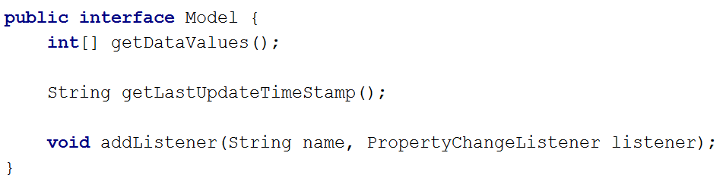
public class DataModel implements Model { private int x; private int y; private int z; private String lastUpdate; private Random random = new Random(); private PropertyChangeSupport changeSupport = new PropertyChangeSupport(this); @Override public int[] getDataValues() { return new int[]{x, y, z}; } @Override public String getLastUpdateTimeStamp() { return lastUpdate; } @Override public void addListener(String name, PropertyChangeListener listener) { if(name == null) changeSupport.addPropertyChangeListener(listener); else changeSupport.addPropertyChangeListener(name, listener); } public void recalculateData() { int first = random.nextInt(100)+1; int second = random.nextInt(100)+1; int bottom = Math.min(first, second); int top = Math.max(first, second); x = bottom; y = top - bottom; z = 100 - top; System.out.println("1: " + x); System.out.println("2: " + y); System.out.println("3: " + z); System.out.println("Sum: " + (x + y + z)); changeSupport.firePropertyChange("Data", null, new int[]{x, y, z}); calTimeStamp(); } private void calTimeStamp() { SimpleDateFormat sdfDate = new SimpleDateFormat("HH:mm:ss"); Date now = new Date(); String strDate = sdfDate.format(now); System.out.println(strDate); changeSupport.firePropertyChange("TimeUpdate", lastUpdate, strDate); lastUpdate = strDate; } }
FXML
PieChartV
PieChartVM
<<Model>> could also extend the Subject interface from the Observer session
<<Subject>>
<<Model>>
DataModel

Slide 24
public class DataModel implements Model { private int x; private int y; private int z; private String lastUpdate; private Random random = new Random(); private PropertyChangeSupport changeSupport = new PropertyChangeSupport(this); @Override public int[] getDataValues() { return new int[]{x, y, z}; } @Override public String getLastUpdateTimeStamp() { return lastUpdate; } @Override public void addListener(String name, PropertyChangeListener listener) { if(name == null) changeSupport.addPropertyChangeListener(listener); else changeSupport.addPropertyChangeListener(name, listener); } public void recalculateData() { int first = random.nextInt(100)+1; int second = random.nextInt(100)+1; int bottom = Math.min(first, second); int top = Math.max(first, second); x = bottom; y = top - bottom; z = 100 - top; System.out.println("1: " + x); System.out.println("2: " + y); System.out.println("3: " + z); System.out.println("Sum: " + (x + y + z)); changeSupport.firePropertyChange("Data", null, new int[]{x, y, z}); calTimeStamp(); } private void calTimeStamp() { SimpleDateFormat sdfDate = new SimpleDateFormat("HH:mm:ss"); Date now = new Date(); String strDate = sdfDate.format(now); System.out.println(strDate); changeSupport.firePropertyChange("TimeUpdate", lastUpdate, strDate); lastUpdate = strDate; } }
FXML
PieChartV
PieChartVM
<<Model>>
DataModel

Slide 25
public class DataModel implements Model { private int x; private int y; private int z; private String lastUpdate; private Random random = new Random(); private PropertyChangeSupport changeSupport = new PropertyChangeSupport(this); @Override public int[] getDataValues() { return new int[]{x, y, z}; } @Override public String getLastUpdateTimeStamp() { return lastUpdate; } @Override public void addListener(String name, PropertyChangeListener listener) { if(name == null) changeSupport.addPropertyChangeListener(listener); else changeSupport.addPropertyChangeListener(name, listener); } public void recalculateData() { int first = random.nextInt(100)+1; int second = random.nextInt(100)+1; int bottom = Math.min(first, second); int top = Math.max(first, second); x = bottom; y = top - bottom; z = 100 - top; System.out.println("1: " + x); System.out.println("2: " + y); System.out.println("3: " + z); System.out.println("Sum: " + (x + y + z)); changeSupport.firePropertyChange("Data", null, new int[]{x, y, z}); calTimeStamp(); } private void calTimeStamp() { SimpleDateFormat sdfDate = new SimpleDateFormat("HH:mm:ss"); Date now = new Date(); String strDate = sdfDate.format(now); System.out.println(strDate); changeSupport.firePropertyChange("TimeUpdate", lastUpdate, strDate); lastUpdate = strDate; } }
FXML
PieChartV
PieChartVM
<<Model>>
DataModel

Slide 26
public class DataModel implements Model { private int x; private int y; private int z; private String lastUpdate; private Random random = new Random(); private PropertyChangeSupport changeSupport = new PropertyChangeSupport(this); @Override public int[] getDataValues() { return new int[]{x, y, z}; } @Override public String getLastUpdateTimeStamp() { return lastUpdate; } @Override public void addListener(String name, PropertyChangeListener listener) { if(name == null) changeSupport.addPropertyChangeListener(listener); else changeSupport.addPropertyChangeListener(name, listener); } public void recalculateData() { int first = random.nextInt(100)+1; int second = random.nextInt(100)+1; int bottom = Math.min(first, second); int top = Math.max(first, second); x = bottom; y = top - bottom; z = 100 - top; System.out.println("1: " + x); System.out.println("2: " + y); System.out.println("3: " + z); System.out.println("Sum: " + (x + y + z)); changeSupport.firePropertyChange("Data", null, new int[]{x, y, z}); calTimeStamp(); } private void calTimeStamp() { SimpleDateFormat sdfDate = new SimpleDateFormat("HH:mm:ss"); Date now = new Date(); String strDate = sdfDate.format(now); System.out.println(strDate); changeSupport.firePropertyChange("TimeUpdate", lastUpdate, strDate); lastUpdate = strDate; } }
FXML
PieChartV
Could give array of old values
PieChartVM
<<Model>>
DataModel

Slide 27
public class DataModel implements Model { private int x; private int y; private int z; private String lastUpdate; private Random random = new Random(); private PropertyChangeSupport changeSupport = new PropertyChangeSupport(this); @Override public int[] getDataValues() { return new int[]{x, y, z}; } @Override public String getLastUpdateTimeStamp() { return lastUpdate; } @Override public void addListener(String name, PropertyChangeListener listener) { if(name == null) changeSupport.addPropertyChangeListener(listener); else changeSupport.addPropertyChangeListener(name, listener); } public void recalculateData() { int first = random.nextInt(100)+1; int second = random.nextInt(100)+1; int bottom = Math.min(first, second); int top = Math.max(first, second); x = bottom; y = top - bottom; z = 100 - top; System.out.println("1: " + x); System.out.println("2: " + y); System.out.println("3: " + z); System.out.println("Sum: " + (x + y + z)); changeSupport.firePropertyChange("Data", null, new int[]{x, y, z}); calTimeStamp(); } private void calTimeStamp() { SimpleDateFormat sdfDate = new SimpleDateFormat("HH:mm:ss"); Date now = new Date(); String strDate = sdfDate.format(now); System.out.println(strDate); changeSupport.firePropertyChange("TimeUpdate", lastUpdate, strDate); lastUpdate = strDate; } }
public class PieChartViewModel { private DoubleProperty x; private DoubleProperty y; private DoubleProperty z; private StringProperty updateTimeStamp; private Model model; public PieChartViewModel(Model model) { this.model = model; x = new SimpleDoubleProperty(); y = new SimpleDoubleProperty(); z = new SimpleDoubleProperty(); updateTimeStamp = new SimpleStringProperty("Last update: "); model.addListener("Data", evt -> updatePieChart(evt)); model.addListener("TimeUpdate", evt -> timeStampUpdated(evt)); } public void updatePieChart(PropertyChangeEvent evt) { Platform.runLater(() -> { int[] vals = (int[]) evt.getNewValue(); x.setValue(vals[0]); y.setValue(vals[1]); z.setValue(vals[2]); }); } private void timeStampUpdated(PropertyChangeEvent evt) { Platform.runLater(() -> { updateTimeStamp.setValue("Last updated: " + evt.getNewValue()); }); }
FXML
PieChartV
PieChartVM
<<Model>>
DataModel

Slide 28
public class DataModel implements Model { private int x; private int y; private int z; private String lastUpdate; private Random random = new Random(); private PropertyChangeSupport changeSupport = new PropertyChangeSupport(this); @Override public int[] getDataValues() { return new int[]{x, y, z}; } @Override public String getLastUpdateTimeStamp() { return lastUpdate; } @Override public void addListener(String name, PropertyChangeListener listener) { if(name == null) changeSupport.addPropertyChangeListener(listener); else changeSupport.addPropertyChangeListener(name, listener); } public void recalculateData() { int first = random.nextInt(100)+1; int second = random.nextInt(100)+1; int bottom = Math.min(first, second); int top = Math.max(first, second); x = bottom; y = top - bottom; z = 100 - top; System.out.println("1: " + x); System.out.println("2: " + y); System.out.println("3: " + z); System.out.println("Sum: " + (x + y + z)); changeSupport.firePropertyChange("Data", null, new int[]{x, y, z}); calTimeStamp(); } private void calTimeStamp() { SimpleDateFormat sdfDate = new SimpleDateFormat("HH:mm:ss"); Date now = new Date(); String strDate = sdfDate.format(now); System.out.println(strDate); changeSupport.firePropertyChange("TimeUpdate", lastUpdate, strDate); lastUpdate = strDate; } }
public class PieChartViewModel { private DoubleProperty x; private DoubleProperty y; private DoubleProperty z; private StringProperty updateTimeStamp; private Model model; public PieChartViewModel(Model model) { this.model = model; x = new SimpleDoubleProperty(); y = new SimpleDoubleProperty(); z = new SimpleDoubleProperty(); updateTimeStamp = new SimpleStringProperty("Last update: "); model.addListener("Data", evt -> updatePieChart(evt)); model.addListener("TimeUpdate", evt -> timeStampUpdated(evt)); } public void updatePieChart(PropertyChangeEvent evt) { Platform.runLater(() -> { int[] vals = (int[]) evt.getNewValue(); x.setValue(vals[0]); y.setValue(vals[1]); z.setValue(vals[2]); }); } private void timeStampUpdated(PropertyChangeEvent evt) { Platform.runLater(() -> { updateTimeStamp.setValue("Last updated: " + evt.getNewValue()); }); }
FXML
PieChartV
PieChartVM
<<Model>>
DataModel

Slide 29
public class DataModel implements Model { private int x; private int y; private int z; private String lastUpdate; private Random random = new Random(); private PropertyChangeSupport changeSupport = new PropertyChangeSupport(this); @Override public int[] getDataValues() { return new int[]{x, y, z}; } @Override public String getLastUpdateTimeStamp() { return lastUpdate; } @Override public void addListener(String name, PropertyChangeListener listener) { if(name == null) changeSupport.addPropertyChangeListener(listener); else changeSupport.addPropertyChangeListener(name, listener); } public void recalculateData() { int first = random.nextInt(100)+1; int second = random.nextInt(100)+1; int bottom = Math.min(first, second); int top = Math.max(first, second); x = bottom; y = top - bottom; z = 100 - top; System.out.println("1: " + x); System.out.println("2: " + y); System.out.println("3: " + z); System.out.println("Sum: " + (x + y + z)); changeSupport.firePropertyChange("Data", null, new int[]{x, y, z}); calTimeStamp(); } private void calTimeStamp() { SimpleDateFormat sdfDate = new SimpleDateFormat("HH:mm:ss"); Date now = new Date(); String strDate = sdfDate.format(now); System.out.println(strDate); changeSupport.firePropertyChange("TimeUpdate", lastUpdate, strDate); lastUpdate = strDate; } }
public class PieChartViewModel { private DoubleProperty x; private DoubleProperty y; private DoubleProperty z; private StringProperty updateTimeStamp; private Model model; public PieChartViewModel(Model model) { this.model = model; x = new SimpleDoubleProperty(); y = new SimpleDoubleProperty(); z = new SimpleDoubleProperty(); updateTimeStamp = new SimpleStringProperty("Last update: "); model.addListener("Data", evt -> updatePieChart(evt)); model.addListener("TimeUpdate", evt -> timeStampUpdated(evt)); } public void updatePieChart(PropertyChangeEvent evt) { Platform.runLater(() -> { int[] vals = (int[]) evt.getNewValue(); x.setValue(vals[0]); y.setValue(vals[1]); z.setValue(vals[2]); }); } private void timeStampUpdated(PropertyChangeEvent evt) { Platform.runLater(() -> { updateTimeStamp.setValue("Last updated: " + evt.getNewValue()); }); }
FXML
PieChartV
PieChartVM
Notice the Platform.runLater
<<Model>>
DataModel

Slide 30
public class DataModel implements Model { private int x; private int y; private int z; private String lastUpdate; private Random random = new Random(); private PropertyChangeSupport changeSupport = new PropertyChangeSupport(this); @Override public int[] getDataValues() { return new int[]{x, y, z}; } @Override public String getLastUpdateTimeStamp() { return lastUpdate; } @Override public void addListener(String name, PropertyChangeListener listener) { if(name == null) changeSupport.addPropertyChangeListener(listener); else changeSupport.addPropertyChangeListener(name, listener); } public void recalculateData() { int first = random.nextInt(100)+1; int second = random.nextInt(100)+1; int bottom = Math.min(first, second); int top = Math.max(first, second); x = bottom; y = top - bottom; z = 100 - top; System.out.println("1: " + x); System.out.println("2: " + y); System.out.println("3: " + z); System.out.println("Sum: " + (x + y + z)); changeSupport.firePropertyChange("Data", null, new int[]{x, y, z}); calTimeStamp(); } private void calTimeStamp() { SimpleDateFormat sdfDate = new SimpleDateFormat("HH:mm:ss"); Date now = new Date(); String strDate = sdfDate.format(now); System.out.println(strDate); changeSupport.firePropertyChange("TimeUpdate", lastUpdate, strDate); lastUpdate = strDate; } }
public class PieChartViewModel { private DoubleProperty x; private DoubleProperty y; private DoubleProperty z; private StringProperty updateTimeStamp; private Model model; public PieChartViewModel(Model model) { this.model = model; x = new SimpleDoubleProperty(); y = new SimpleDoubleProperty(); z = new SimpleDoubleProperty(); updateTimeStamp = new SimpleStringProperty("Last update: "); model.addListener("Data", evt -> updatePieChart(evt)); model.addListener("TimeUpdate", evt -> timeStampUpdated(evt)); } public void updatePieChart(PropertyChangeEvent evt) { Platform.runLater(() -> { int[] vals = (int[]) evt.getNewValue(); x.setValue(vals[0]); y.setValue(vals[1]); z.setValue(vals[2]); }); } private void timeStampUpdated(PropertyChangeEvent evt) { Platform.runLater(() -> { updateTimeStamp.setValue("Last updated: " + evt.getNewValue()); }); }
FXML
PieChartV
PieChartVM
<<Model>>
DataModel

Slide 31


Slide 32
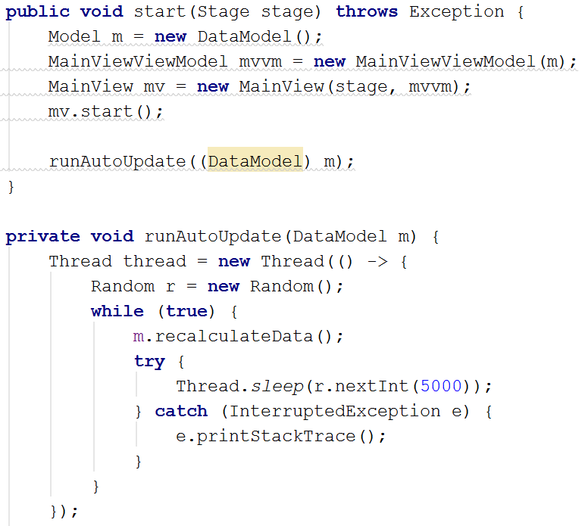
Why Platform.runLater ??
public class DataModel implements Model { private int x; private int y; private int z; private String lastUpdate; private Random random = new Random(); private PropertyChangeSupport changeSupport = new PropertyChangeSupport(this); @Override public int[] getDataValues() { return new int[]{x, y, z}; } @Override public String getLastUpdateTimeStamp() { return lastUpdate; } @Override public void addListener(String name, PropertyChangeListener listener) { if(name == null) changeSupport.addPropertyChangeListener(listener); else changeSupport.addPropertyChangeListener(name, listener); } public void recalculateData() { int first = random.nextInt(100)+1; int second = random.nextInt(100)+1; int bottom = Math.min(first, second); int top = Math.max(first, second); x = bottom; y = top - bottom; z = 100 - top; System.out.println("1: " + x); System.out.println("2: " + y); System.out.println("3: " + z); System.out.println("Sum: " + (x + y + z)); changeSupport.firePropertyChange("Data", null, new int[]{x, y, z}); calTimeStamp(); } private void calTimeStamp() { SimpleDateFormat sdfDate = new SimpleDateFormat("HH:mm:ss"); Date now = new Date(); String strDate = sdfDate.format(now); System.out.println(strDate); changeSupport.firePropertyChange("TimeUpdate", lastUpdate, strDate); lastUpdate = strDate; } }
public class PieChartViewModel { private DoubleProperty x; private DoubleProperty y; private DoubleProperty z; private StringProperty updateTimeStamp; private Model model; public PieChartViewModel(Model model) { this.model = model; x = new SimpleDoubleProperty(); y = new SimpleDoubleProperty(); z = new SimpleDoubleProperty(); updateTimeStamp = new SimpleStringProperty("Last update: "); model.addListener("Data", evt -> updatePieChart(evt)); model.addListener("TimeUpdate", evt -> timeStampUpdated(evt)); } public void updatePieChart(PropertyChangeEvent evt) { Platform.runLater(() -> { int[] vals = (int[]) evt.getNewValue(); x.setValue(vals[0]); y.setValue(vals[1]); z.setValue(vals[2]); }); } private void timeStampUpdated(PropertyChangeEvent evt) { Platform.runLater(() -> { updateTimeStamp.setValue("Last updated: " + evt.getNewValue()); }); }
The start method started the JavaFX application
It also started another thread to update the model
Only JavaFX threads can update JavaFX Properties.

Slide 33
Why Platform.runLater ??
public class DataModel implements Model { private int x; private int y; private int z; private String lastUpdate; private Random random = new Random(); private PropertyChangeSupport changeSupport = new PropertyChangeSupport(this); @Override public int[] getDataValues() { return new int[]{x, y, z}; } @Override public String getLastUpdateTimeStamp() { return lastUpdate; } @Override public void addListener(String name, PropertyChangeListener listener) { if(name == null) changeSupport.addPropertyChangeListener(listener); else changeSupport.addPropertyChangeListener(name, listener); } public void recalculateData() { int first = random.nextInt(100)+1; int second = random.nextInt(100)+1; int bottom = Math.min(first, second); int top = Math.max(first, second); x = bottom; y = top - bottom; z = 100 - top; System.out.println("1: " + x); System.out.println("2: " + y); System.out.println("3: " + z); System.out.println("Sum: " + (x + y + z)); changeSupport.firePropertyChange("Data", null, new int[]{x, y, z}); calTimeStamp(); } private void calTimeStamp() { SimpleDateFormat sdfDate = new SimpleDateFormat("HH:mm:ss"); Date now = new Date(); String strDate = sdfDate.format(now); System.out.println(strDate); changeSupport.firePropertyChange("TimeUpdate", lastUpdate, strDate); lastUpdate = strDate; } }
public class PieChartViewModel { private DoubleProperty x; private DoubleProperty y; private DoubleProperty z; private StringProperty updateTimeStamp; private Model model; public PieChartViewModel(Model model) { this.model = model; x = new SimpleDoubleProperty(); y = new SimpleDoubleProperty(); z = new SimpleDoubleProperty(); updateTimeStamp = new SimpleStringProperty("Last update: "); model.addListener("Data", evt -> updatePieChart(evt)); model.addListener("TimeUpdate", evt -> timeStampUpdated(evt)); } public void updatePieChart(PropertyChangeEvent evt) { Platform.runLater(() -> { int[] vals = (int[]) evt.getNewValue(); x.setValue(vals[0]); y.setValue(vals[1]); z.setValue(vals[2]); }); } private void timeStampUpdated(PropertyChangeEvent evt) { Platform.runLater(() -> { updateTimeStamp.setValue("Last updated: " + evt.getNewValue()); }); }
The start method started the JavaFX application
It also started another thread to update the model
Only JavaFX threads can update JavaFX Properties.

Slide 34
Why Platform.runLater ??
public class DataModel implements Model { private int x; private int y; private int z; private String lastUpdate; private Random random = new Random(); private PropertyChangeSupport changeSupport = new PropertyChangeSupport(this); @Override public int[] getDataValues() { return new int[]{x, y, z}; } @Override public String getLastUpdateTimeStamp() { return lastUpdate; } @Override public void addListener(String name, PropertyChangeListener listener) { if(name == null) changeSupport.addPropertyChangeListener(listener); else changeSupport.addPropertyChangeListener(name, listener); } public void recalculateData() { int first = random.nextInt(100)+1; int second = random.nextInt(100)+1; int bottom = Math.min(first, second); int top = Math.max(first, second); x = bottom; y = top - bottom; z = 100 - top; System.out.println("1: " + x); System.out.println("2: " + y); System.out.println("3: " + z); System.out.println("Sum: " + (x + y + z)); changeSupport.firePropertyChange("Data", null, new int[]{x, y, z}); calTimeStamp(); } private void calTimeStamp() { SimpleDateFormat sdfDate = new SimpleDateFormat("HH:mm:ss"); Date now = new Date(); String strDate = sdfDate.format(now); System.out.println(strDate); changeSupport.firePropertyChange("TimeUpdate", lastUpdate, strDate); lastUpdate = strDate; } }
public class PieChartViewModel { private DoubleProperty x; private DoubleProperty y; private DoubleProperty z; private StringProperty updateTimeStamp; private Model model; public PieChartViewModel(Model model) { this.model = model; x = new SimpleDoubleProperty(); y = new SimpleDoubleProperty(); z = new SimpleDoubleProperty(); updateTimeStamp = new SimpleStringProperty("Last update: "); model.addListener("Data", evt -> updatePieChart(evt)); model.addListener("TimeUpdate", evt -> timeStampUpdated(evt)); } public void updatePieChart(PropertyChangeEvent evt) { Platform.runLater(() -> { int[] vals = (int[]) evt.getNewValue(); x.setValue(vals[0]); y.setValue(vals[1]); z.setValue(vals[2]); }); } private void timeStampUpdated(PropertyChangeEvent evt) { Platform.runLater(() -> { updateTimeStamp.setValue("Last updated: " + evt.getNewValue()); }); }
Model
The start method started the JavaFX application
It also started another thread to update the model
Only JavaFX threads can update JavaFX Properties.

Slide 35
Why Platform.runLater ??
public class DataModel implements Model { private int x; private int y; private int z; private String lastUpdate; private Random random = new Random(); private PropertyChangeSupport changeSupport = new PropertyChangeSupport(this); @Override public int[] getDataValues() { return new int[]{x, y, z}; } @Override public String getLastUpdateTimeStamp() { return lastUpdate; } @Override public void addListener(String name, PropertyChangeListener listener) { if(name == null) changeSupport.addPropertyChangeListener(listener); else changeSupport.addPropertyChangeListener(name, listener); } public void recalculateData() { int first = random.nextInt(100)+1; int second = random.nextInt(100)+1; int bottom = Math.min(first, second); int top = Math.max(first, second); x = bottom; y = top - bottom; z = 100 - top; System.out.println("1: " + x); System.out.println("2: " + y); System.out.println("3: " + z); System.out.println("Sum: " + (x + y + z)); changeSupport.firePropertyChange("Data", null, new int[]{x, y, z}); calTimeStamp(); } private void calTimeStamp() { SimpleDateFormat sdfDate = new SimpleDateFormat("HH:mm:ss"); Date now = new Date(); String strDate = sdfDate.format(now); System.out.println(strDate); changeSupport.firePropertyChange("TimeUpdate", lastUpdate, strDate); lastUpdate = strDate; } }
public class PieChartViewModel { private DoubleProperty x; private DoubleProperty y; private DoubleProperty z; private StringProperty updateTimeStamp; private Model model; public PieChartViewModel(Model model) { this.model = model; x = new SimpleDoubleProperty(); y = new SimpleDoubleProperty(); z = new SimpleDoubleProperty(); updateTimeStamp = new SimpleStringProperty("Last update: "); model.addListener("Data", evt -> updatePieChart(evt)); model.addListener("TimeUpdate", evt -> timeStampUpdated(evt)); } public void updatePieChart(PropertyChangeEvent evt) { Platform.runLater(() -> { int[] vals = (int[]) evt.getNewValue(); x.setValue(vals[0]); y.setValue(vals[1]); z.setValue(vals[2]); }); } private void timeStampUpdated(PropertyChangeEvent evt) { Platform.runLater(() -> { updateTimeStamp.setValue("Last updated: " + evt.getNewValue()); }); }
The start method started the JavaFX application
It also started another thread to update the model
Only JavaFX threads can update JavaFX Properties.

Slide 36
Why Platform.runLater ??
public class DataModel implements Model { private int x; private int y; private int z; private String lastUpdate; private Random random = new Random(); private PropertyChangeSupport changeSupport = new PropertyChangeSupport(this); @Override public int[] getDataValues() { return new int[]{x, y, z}; } @Override public String getLastUpdateTimeStamp() { return lastUpdate; } @Override public void addListener(String name, PropertyChangeListener listener) { if(name == null) changeSupport.addPropertyChangeListener(listener); else changeSupport.addPropertyChangeListener(name, listener); } public void recalculateData() { int first = random.nextInt(100)+1; int second = random.nextInt(100)+1; int bottom = Math.min(first, second); int top = Math.max(first, second); x = bottom; y = top - bottom; z = 100 - top; System.out.println("1: " + x); System.out.println("2: " + y); System.out.println("3: " + z); System.out.println("Sum: " + (x + y + z)); changeSupport.firePropertyChange("Data", null, new int[]{x, y, z}); calTimeStamp(); } private void calTimeStamp() { SimpleDateFormat sdfDate = new SimpleDateFormat("HH:mm:ss"); Date now = new Date(); String strDate = sdfDate.format(now); System.out.println(strDate); changeSupport.firePropertyChange("TimeUpdate", lastUpdate, strDate); lastUpdate = strDate; } }
public class PieChartViewModel { private DoubleProperty x; private DoubleProperty y; private DoubleProperty z; private StringProperty updateTimeStamp; private Model model; public PieChartViewModel(Model model) { this.model = model; x = new SimpleDoubleProperty(); y = new SimpleDoubleProperty(); z = new SimpleDoubleProperty(); updateTimeStamp = new SimpleStringProperty("Last update: "); model.addListener("Data", evt -> updatePieChart(evt)); model.addListener("TimeUpdate", evt -> timeStampUpdated(evt)); } public void updatePieChart(PropertyChangeEvent evt) { Platform.runLater(() -> { int[] vals = (int[]) evt.getNewValue(); x.setValue(vals[0]); y.setValue(vals[1]); z.setValue(vals[2]); }); } private void timeStampUpdated(PropertyChangeEvent evt) { Platform.runLater(() -> { updateTimeStamp.setValue("Last updated: " + evt.getNewValue()); }); }
The start method started the JavaFX application
It also started another thread to update the model
A non-JavaFX thread attempts to update properties
Only JavaFX threads can update JavaFX Properties.

Slide 37
Why Platform.runLater ??
So whenever a non-JavaFX thread attempts to update properties, we must wrap it in a Platform.runLater
You’ll encounter a similar problem, when data from a Server is pushed to the Client, which then updates the model…

Slide 38


Slide 39
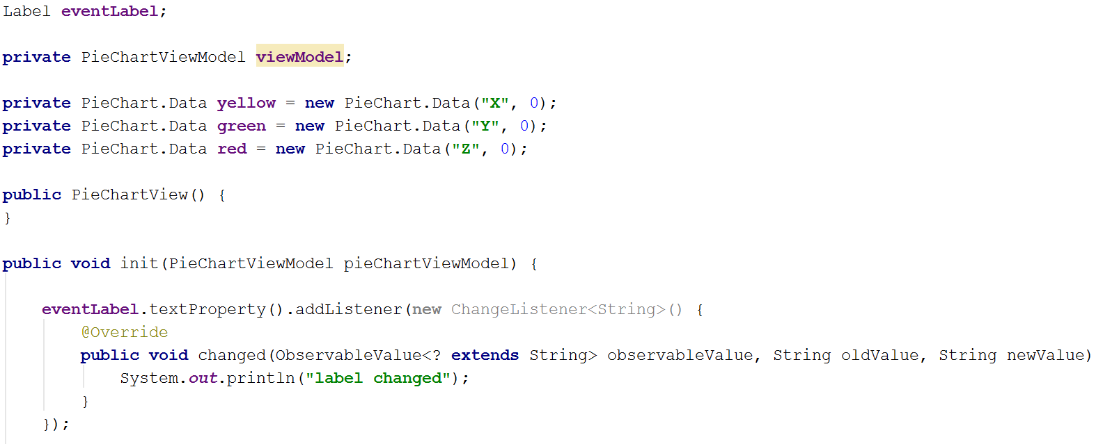
Listening for property changes
Properties can be bound together, so when one property is modified, another property will automatically reflect this.
You can also add listeners to properties:

Slide 40
Listening for property changes
Properties can be bound together, so when one property is modified, another property will automatically reflect this.
You can also add listeners to properties:
Add the ChangeListener to the property

Slide 41
Listening for property changes
Properties can be bound together, so when one property is modified, another property will automatically reflect this.
You can also add listeners to properties:
The property it-self

Slide 42
Listening for property changes
Properties can be bound together, so when one property is modified, another property will automatically reflect this.
You can also add listeners to properties:
Old and new values

Slide 43
Listening for property changes
Properties can be bound together, so when one property is modified, another property will automatically reflect this.
You can also add listeners to properties:
Put your code here

Slide 44


Slide 45
Anyone here?

Slide 46


